Slide 1
INTRODUCTION TO OPERATING SYSTEM
An operating system (OS) is system software that manages computer hardware and software resources and provides common services for computer programs.
It also allows you to communicate with the computer without knowing how to speak the computer's language.

Slide 2
NEED OF OPERATING SYSTEM:
Software which performs all the basic tasks .
Handles input and output.
controls peripheral devices such as disk drives and printers.

Slide 3
TYPES OF OPERATING SYSTEM
Time-sharing operating systems
Network operating System
Distributed operating System
Real Time operating System

Slide 4
WINDOWS OPERATING SYSTEM
The application programs must be written to run on top of a particular operating system.
Your choice of operating system determines to a great extent the applications you can run.
For PCs, the most popular operating systems are DOS, OS/2, and Windows, but others are available, such as Linux.

Slide 5
WINDOWS WORKSTATION:
Any PC running Windows .
Using a Windows server as a client PC.
The server versions of Windows are occasionally used as desktop computers to take advantage of the additional robustness and features built into server products.
WINDOWS SERVER OS:
It is a series of enterprise-class server operating systems designed to share services with multiple users and provide extensive administrative control of data storage, applications and corporate networks.

Slide 6
WINDOWS WORKSTATION -VERSION NUMBERS:
Operating System Version Number
Windows 1.0 1.04
Windows NT 3.1 3.10.528
Windows NT Workstation 3.5 3.5.807
Windows NT Workstation 3.51 3.51.1057
Windows NT Workstation 4.0 4.0.1381
Windows 98 4.1.1998
Windows 98 Second Edition 4.1.2222
Windows 7 6.1.7600
Windows 10 10.0.10240

Slide 7
Windows Server –versions
Name Release date Release version number
Windows Server 2016 2016 NT 10.0
Windows Server 2012 R2 2013 NT 6.3
Windows Server 2012 2012 NT 6.2
Windows Server 2008 R2 2009 NT 6.1

Slide 8
Windows Server 2012 System Requirements:
Component Minimum Requirement Recommended
Processor 1.4GHZ 64-bit 2GHZ or faster dual core
Memory 512MB RAM 2GB RAM or greater
Disk space 32GB 40GB Full installation or 10GB Server
core installation

Slide 9
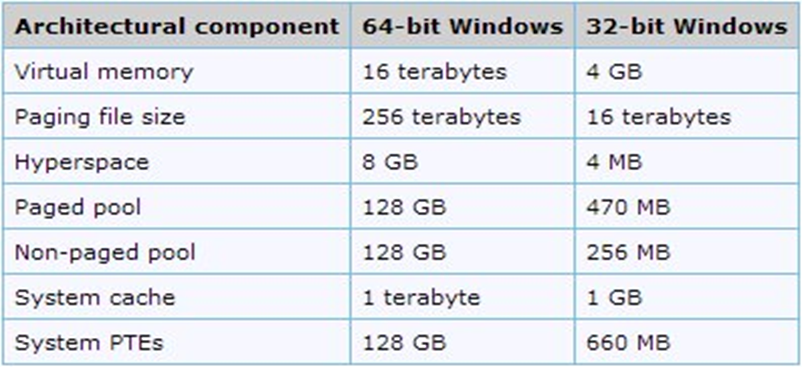
Windows 64 bit Vs Windows 32 bit

Slide 10
KERNEL
A kernel is a central component of an operating system.
It acts as an interface between the user applications and the hardware.
The sole aim of the kernel is to manage the communication between the software (user level applications) and the hardware (CPU, disk memory etc).
The main tasks of the kernel are :
Process management
Device management
Memory management
Interrupt handling
I/O communication
File system

Slide 11
TYPES OF KERNEL
Kernels may be classified mainly in two categories
Monolithic
Micro Kernel

Slide 12
MODES OF KERNEL
User mode:
The executing code has no ability to directly access hardware or reference memory.
Code running in user mode must delegate to system APIs to access hardware or memory.
Crashes in user mode are always recoverable.
Most of the code running on your computer will execute in user mode.

Slide 13
Kernel mode:
The executing code has complete and unrestricted access to the underlying hardware.
It can execute any CPU instruction and reference any memory address.
Kernel mode is generally reserved for the lowest-level, most trusted functions of the operating system.
Crashes in kernel mode are catastrophic; they will halt the entire PC.

Slide 14
COMPONENTS OF KERNEL
HAL:
Hardware abstraction layer is a layer of programming that allows a computer operating system to interact with a hardware device at a general or abstract level rather than at a detailed hardware level.
Windows 2000 is one of several operating systems that include a hardware abstraction layer.
The hardware abstraction layer can be called from either the operating system's kernel or from a device driver.

Slide 15
Executive services:
The executive services in the windows kernel are:
Object management.
Memory management.
Process and thread management.
Input/output management.
Configuration management.

Slide 16
CONFIGURATION MANAGER
It is one of the executive services of the windows-kernel mode.
The Windows kernel-mode configuration manager manages the registry.
If your driver needs to know about changes in the registry, it can use the routines of the configuration manager to do so by registering callbacks on specific registry data.

Slide 17
I/O MANAGER
The Windows kernel-mode I/O manager manages the communication between applications and the interfaces provided by device drivers.
The communication between the operating system and device drivers is primarily done through I/O request packets (IRPs).
The I/O Manager integrates various networking components, including the following:
File system drivers
Networking protocols
Network adapter card drivers

Slide 18
LOCAL PROCEDURE CALL
The Local Procedure Call Facility (LPC Facility) provides the mechanism for client and server components to send messages to each other.
It is a high speed message based communication mechanism implemented in the NT kernel.
LPC can be used for communication between two user mode processes, between a user mode process and a kernel mode driver or between two kernel mode drivers.

Slide 19
MEMORY MANAGER
The Windows kernel-mode memory manager component manages physical memory for the operating system.
This memory is primarily in the form of random access memory (RAM).
The memory manager manages memory by performing the following major tasks:
Managing the allocation and deallocation of memory virtually and dynamically.
Supporting the concepts of memory-mapped files, shared memory, and copy-on-write.

Slide 20
PROCESS STRUCTURE

Slide 21
PnP MANAGER
The Plug and Play (PnP) manager provides the support for PnP functionality in Windows and is responsible for the following PnP-related tasks:
Device detection and enumeration while the system is booting
Adding or removing devices while the system is running
The kernel-mode PnP manager notifies the user-mode PnP manager that a new device is present on the system and must be installed.
The PnP manager maintains the Device Tree that keeps track of the devices in the system.

Slide 22
SECURITY REFERENCE MONITOR
An increasingly important aspect of operating systems is security.
Before an action can take place, the operating system must be sure that the action is not a violation of system policy.
Windows uses an access control list (ACL) to determine which objects have what security.
The Windows kernel-mode security reference monitor provides routines for your driver to work with access control.

Slide 23
GRAPHIC DEVICE DRIVERS

Slide 24
DEVICE DRIVERS
A device driver is a computer program that operates or controls a particular type of device that is attached to a computer.
A driver provides a software interface to hardware devices, enabling operating systems and other computer programs to access hardware functions without needing to know precise details of the hardware being used.
A driver communicates with the device through the computer bus or communications subsystem to which the hardware connects.
Drivers are hardware dependent and operating-system-specific.

